Slide 1
Recap : Classification vs Regression
Classification means to group the output into a class. | Regression means to predict the output value using training data.
If it is discrete/categorical variable, then it is classification problem. | If it is a real number/continuous, then it is regression problem.
Classification to predict the type of tumor ie; harmful or not harmful using training data. | Regression is to predict the house price from training data.

Slide 2
Recap
Supervised Learning vs Unsupervised Learning ?

Slide 3
Few terminologies frequently used in ML
Independent Variables – also called Features/Predictor/Explanatory Variable
Dependent Variables – also called Outcome/Response
Train – training the model means creating the model.
Test – testing the model meaning checking the accuracy of the model.
Dataset – contains a collection of several pieces of information that are used to train the ML algorithm.
Bias – While making predictions, a difference occurs between the predicted values made by the model and the actual/expected values. This difference is called bias error.
Low Bias: A low bias model will make fewer assumptions about the form of the target function.
High Bias: A model with a high bias makes more assumptions, and the model becomes unable to capture the important features of our dataset. A high bias model also cannot perform well on new data.
Variance – specifies the amount of variation in the prediction if different training dataset is used. Ideally a model should have low variance meaning it is able to understand the mapping between the input and output variables.
The combination of low bias and low variance is ideal for a ML model.

Slide 4
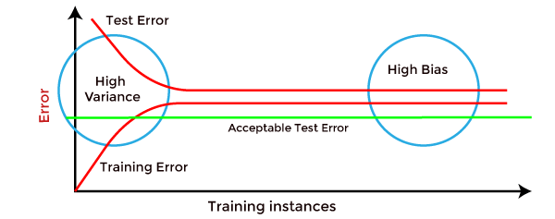
High variance can be identified if the model has:
Low training error and high test error.
High Bias can be identified if the model has:
High training error and the test error is almost similar to training error.

Slide 5
Different Combinations of Bias-Variance
There are four possible combinations of bias and variances
Low-Bias, Low-Variance:
The combination of low bias and low variance shows an ideal machine learning model. However, it is not possible practically.
Low-Bias, High-Variance:
With low bias and high variance, model predictions are inconsistent and accurate on average. This case occurs when the model learns with a large number of parameters and hence leads to an overfitting
High-Bias, Low-Variance:
With High bias and low variance, predictions are consistent but inaccurate on average. This case occurs when a model does not learn well with the training dataset or uses few numbers of the parameter. It leads to underfitting problems in the model.
High-Bias, High-Variance:
With high bias and high variance, predictions are inconsistent and also inaccurate on average.

Slide 6
What is Bias Variance Tradeoff?
If our model is too simple and has very few parameters then it may have high bias and low variance. On the other hand if our model has large number of parameters then it’s going to have high variance and low bias. So we need to find the right/good balance without overfitting and underfitting the data.

Slide 7
OVERFITTING AND UNDERFITTING
Overfitting & underfitting are the two main errors/problems in the machine learning model, which cause poor performance in Machine Learning.
Overfitting occurs when the model fits more data than required, and it tries to capture each and every datapoint fed to it. Hence it starts capturing noise and inaccurate data from the dataset, which degrades the performance of the model.
An overfitted model doesn't perform accurately with the test/unseen dataset and can’t generalize well.
An overfitted model is said to have low bias and high variance.

Slide 8
How to detect Overfitting?
Overfitting in the model can only be detected once you test the data. To detect the issue, we can perform Train/test split.
In the train-test split of the dataset, we can divide our dataset into random test and training datasets. We train the model with a training dataset which is about 80% of the total dataset. After training the model, we test it with the test dataset, which is 20% of the total dataset.
Now, if the model performs well with the training dataset but not with the test dataset, then it is likely to have an overfitting issue.
For example, if the model shows 85% accuracy with training data and 50% accuracy with the test dataset, it means the model is not performing well.

Slide 9
Underfitting
Underfitting occurs when our machine learning model is not able to capture the underlying trend of the data. To avoid the overfitting in the model, the fed of training data can be stopped at an early stage, due to which the model may not learn enough from the training data. As a result, it may fail to find the best fit of the dominant trend in the data.
In the case of underfitting, the model is not able to learn enough from the training data, and hence it reduces the accuracy and produces unreliable predictions.
An underfitted model has high bias and low variance.

